Slide 1
2019 Illini Statistics Datathon
Team 50: Gajan Kumar, Collin Kauss, Anthony Lee, Chris Zhu

Slide 2
Model Overview
Long Short-Term Memory (LSTM) Network
Implemented with Keras
Trained model for each company separately
Highlighted features:
Past 45 days stock values
Moving averages of sizes 3, 10, 30
Scaled month and day with sin/cos

Slide 3
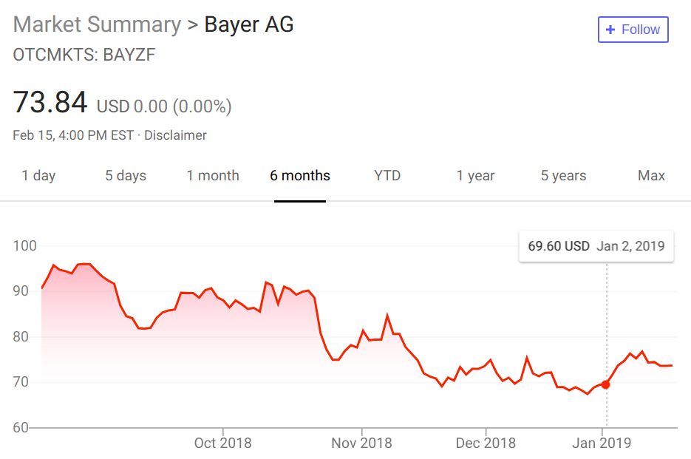
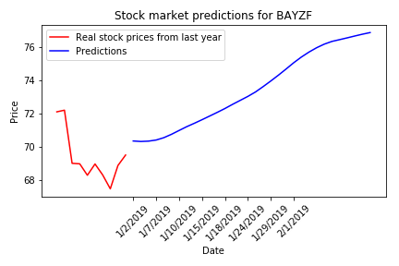
BAYZF
Price on 12/31/18: $69.50
Predicted value 2/15/19: $76.90
Change: +$7.40

Slide 4
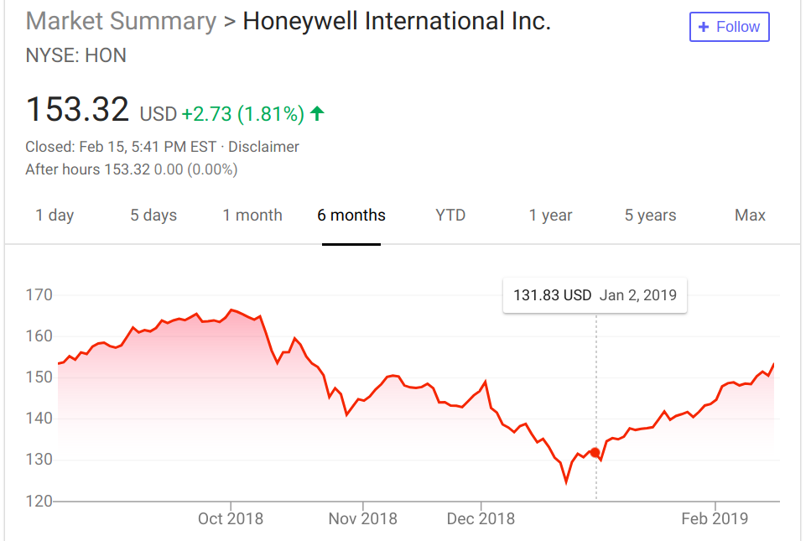
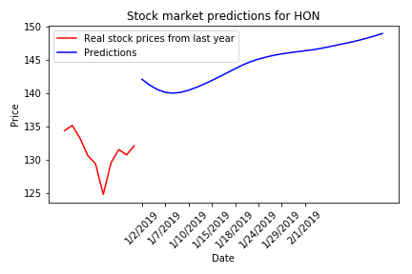
HON
Price on 12/31/18: $132.12
Predicted value 2/15/19: $148.94
Change: +$16.82

Slide 5
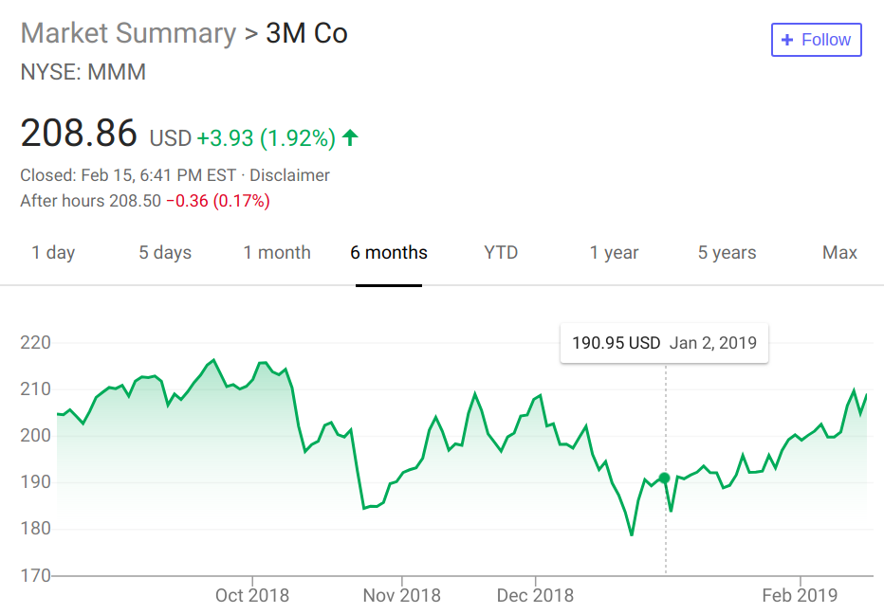
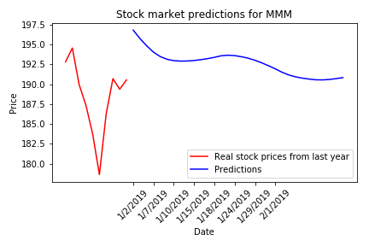
MMM
Price on 12/31/18: $190.54
Predicted value 2/15/19: $190.84
Change: +$0.30

Slide 6
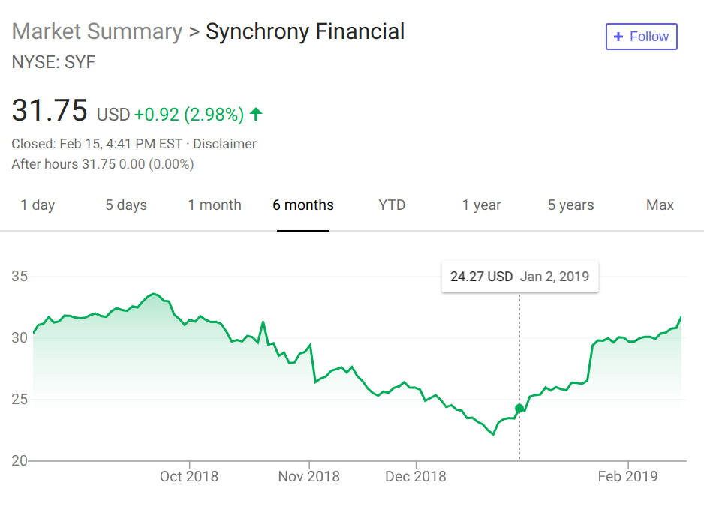
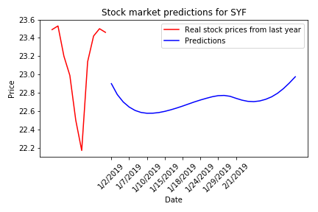
SYF
Price on 12/31/18: $23.46
Predicted value 2/15/19: $22.98
Change: -$0.48

Slide 7
Prediction Summary & Recommendations
 | Company
 | BAYZF | HON | MMM | SYF
Price on 12/31/18 | $69.50 | $132.12 | $190.54 | $23.46
Predicted price 2/15/19 | $76.90 | $148.94 | $190.84 | $22.98
Change | +$7.40 | +$16.82 | +$0.30 | -$0.48
Recommend: HON > BAYZF
Not sure: MMM & SYF

Slide 8
Capital Asset Pricing Model - CAPM
Describes the relationship between systemic risk (overall market performance) and expected return for assets
General idea: much easier to predict long term trends in the economy
Synchrony, 3M, Bayer, and Honeywell are all cyclical companies, meaning they tend to follow certain patterns during economic cycles

Slide 9


Calculating Expected Returns - CAPM
ER_{i} = Expected return of investment R_{f} = Risk-free rate (we used US treasury bond rate) β_{i} = Beta of the investment (Covariance(asset, market) / Var(market)) ER_{m} = Expected return of market R_{f} accounts for the time-value of money, and β_{i} accounts for the volatility of the stock

Slide 10
Drawbacks of CAPM
CAPM assumes stock returns and risk are normally distributed
Also assumes the risk-free rate of return remains constant
Market benchmarks like the S&P 500 don’t always reflect the state of the economy accurately
For these reasons, CAPM is generally used to help investors manage their risk rather than predict stock values

Slide 11
NLP: Google Cloud Natural Language API
Took most recent quarterly earnings call transcript for each company
Ran Google Cloud NLP on each one to generate JSON of all sentiment values for each sentence in report
Used Python script to parse JSON files and obtain average polarity of numerical sentiments
Visualized results using GGPlot Library in R
Compared qualitative data with quantitative data analyzed in model

Slide 12
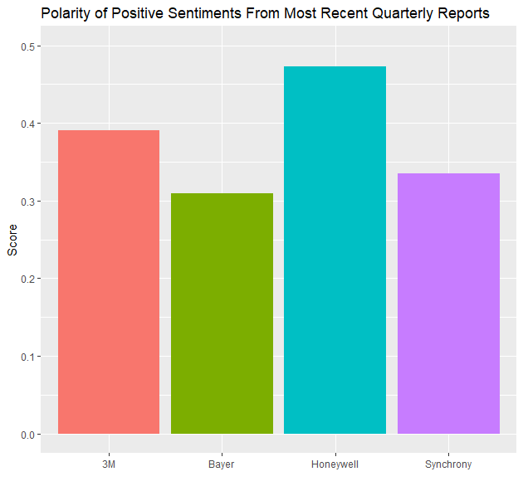
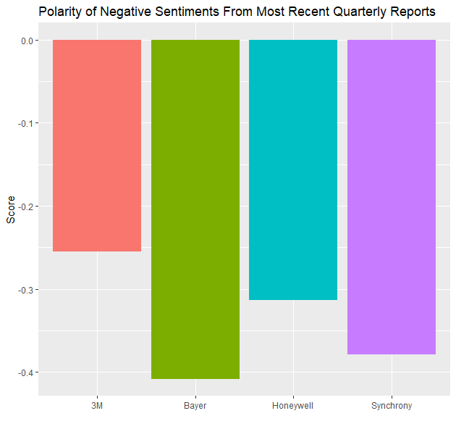

Slide 13
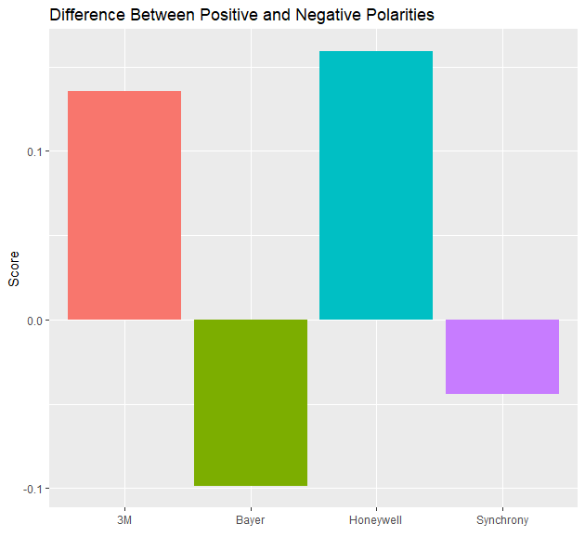

Slide 14
Possible Improvements/Next Steps
New features
Train models longer
Understand which features were most important in making the prediction
Develop a new model by predicting economic trends (i.e. predicting S&P 500 for all of 2019) and applying CAPM
Gather a larger sample size (more quarterly earnings call transcripts) for NLP analysis

Slide 15
Conclusion
Predicting the stock market is difficult
Recommend HON and BAYZF

